Slide 1
Unit 3 Query Languages

Slide 2
Query Languages
Relational Algebra
SQL: DDL, DML, Select Queries, Set, String, Date and Numerical Functions, Aggregate Functions ,Group by and Having Clause
Join Queries, Nested queries
DCL, TCL
PL/SQL: Procedure, Function, Trigger
Mapping of Relational Algebra to SQL

Slide 3
Relational Algebra
The relational algebra provides basic operations which can be performed over single or multiple relations in order to generate new relations(single or multiple).
Relational algebra is a procedural query language which follows a particular syntax with the help of which, data can be accessed and retrieved very easily from single as well as multiple table/data sources.
Relational algebra refers to a procedural query language that takes relation instances as input and returns relation instances as output.
Certain operators are used to perform queries and retrieve desired results.
These operators can perform certain operations on single attribute(called unary operator) or multiple attribute(called binary operator).
Types of operations in relational algebra
1. Basic Operations
2. Derived Operations
Notes:
In simple terms we can say that it’s a mathematical expressions that are used to build a theoretical model for accessing or retrieving data.

Slide 4
Relational Algebra
Basic/Fundamental Operations:
1. Select (σ)
2. Project (∏)
3. Union (∪)
4. Set Difference (-)
5. Cartesian product (X)
6. Rename (ρ)
Derived Operations:
1. Natural Join (⋈)
2. Left, Right, Full outer join (⟕, ⟖, ⟗)
Notes:
Derived-Join, Intersect, Division

Slide 5
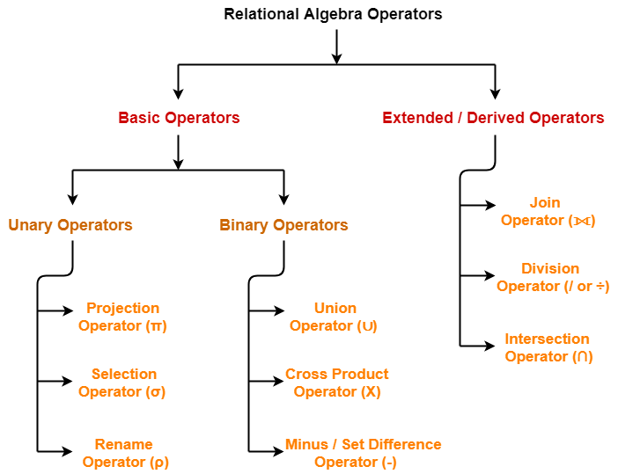

Slide 6
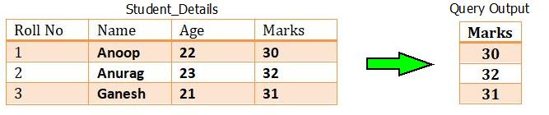
Relational Algebra : Operations
Project(∏): This operation is also used to fetch all the rows/tuples/data according to the requested attribute/Column. It means, using project operation one can simply fetch all the tuples corresponding to a single attribute or multiple attributes. It does not supports any conditions as select operation and is denoted using “Pie(π)”.
Syntax :∏column_name1,column_name2,..,column_nameN(table_name)
Project operator in relational algebra is similar to the Select statement in SQL.
For example : Consider the table of relation R(Roll No, Name, Age, Marks). If we want to project the marks column, then it can be done by :
Query Used : πMarks(Student_Details)
Notes:
It is similar to select statement in SQL but does not support any conditions.

Slide 7
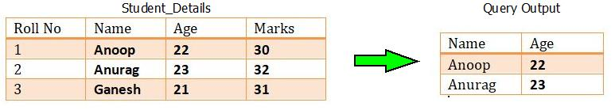
Relational Algebra : Operations
Select (σ): This operation is used to fetch rows from given table or relation on the basis of given conditions, it is denoted by “Sigma(σ)”.
Syntax : σ Condition/Predicate(Relation/Table name)
where clause in SQL, is used for the same purpose.
For example : Consider the table of relation R(Roll No, Name, Age, Marks). If we want to select the name and age of student, then it can be done by:
Query Used : σ Age>21 (Student_Details)
Notes:
Consider a relation Student(RollNo, Name, Age, Course)
If we want to find the names of students older than 18, we can write:
πName(σAge>18(Student)
σ (Selection first) → Filters students where Age > 18.
π (Projection next) → Selects only the "Name" column.

Slide 8
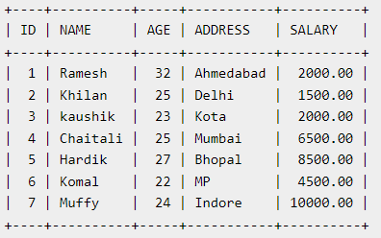
AND and OR Conjunctive Operators
The SQL AND & OR operators are used to combine multiple conditions to narrow data in an SQL statement. These two operators are called as the conjunctive operators.
These operators provide a means to make multiple comparisons with different operators in the same SQL statement.
Q: Find Names of all CUSTOMERs , where the salary is greater than 2000 and the age is less than 25 years .
ᴨ _{Name} [σ_{Salary>2000 and Age<25} (Customer)]
Q: SELECT ID, NAME, SALARY FROM CUSTOMERS WHERE SALARY > 2000 OR age < 25;
ᴨ _{ID,Name , Salary} [σ_{Salary>2000 Or} _{Age<25} (Customer)]

Slide 9
S. No. | Category | Selection | Projection
1. | Other Names | The selection operation is also known as horizontal partitioning. | The Project operation is also known as vertical partitioning.
2. | Use | It is used to choose the subset of tuples from the relation that satisfies the given condition mentioned in the syntax of selection. | It is used to select certain required attributes, while discarding other attributes.
3. | Partitioning | It partitions the table horizontally. | It partitions the table vertically.
4. | Which used first | The selection operation is performed before projection (if they are to be used together). | The projection operation is performed after selection (if they are to be used together).
5 | Column Selection | Select is used to select all columns of a specific tuple. | Project is used to select specific columns.

Slide 10
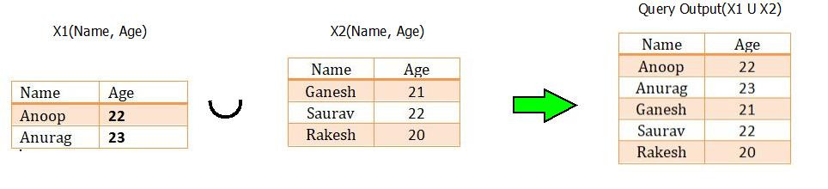
Relational Algebra : Operations
Union(∪):In order to fetch data from two relations to generate new relation with combined capabilities, union operations can be used. The union operation fetches the data from both tables and projects it accordingly. It is denoted through “Union Symbol(U)”.
In Union Operation Both the relations compulsory to have same domain for attributes.
Syntax : X1 U X2 , where X1 & X2 are two different relations satisfying the above two conditions.
Note: The rows (tuples) that are present in both the tables will only appear once in the union set. In short you can say that there are no duplicates present after the union operation.

Slide 11
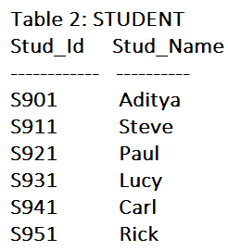
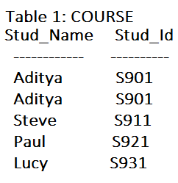
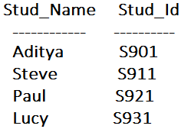

Relational Algebra : Operations
Intersection(∩) : Intersection operator is denoted by ∩ symbol and it is used to select common rows (tuples) from two tables (relations).
Lets say we have two relations R1 and R2 both have same columns and we want to select all those tuples(rows) that are present in both the relations, then in that case we can apply intersection operation on these two relations R1 ∩ R2.
Note: Only those rows that are present in both the tables will appear in the result set. COURSE ∩ STUDENT

Slide 12
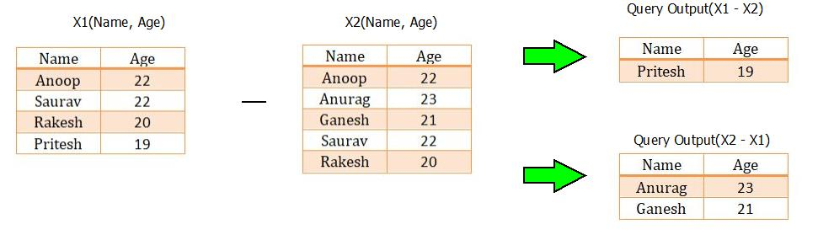
Relational Algebra : Operations
Set Difference (-) : In order to fetch the data which is not present in any one of the relation, set difference operation is used. The set difference operation is denoted by “Minus(-)”.
Lets say we have two relations R1 and R2 and we want to select all those tuples(rows) that are present in Relation R1 but not present in Relation R2, this can be done using Set difference R1 – R2.
For example : Consider the two tables with relations X₁(Name, Age) and X₂(Name, Age). If we wish to apply the set difference operation, then it can be done by :

Slide 13
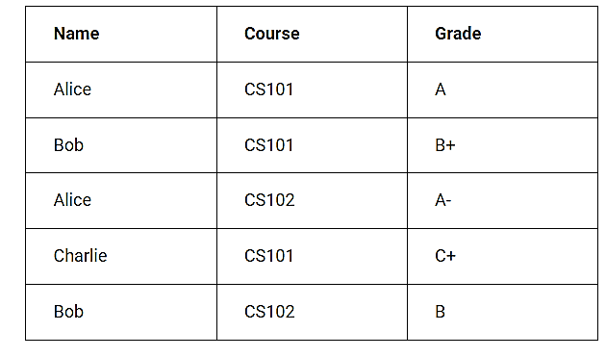
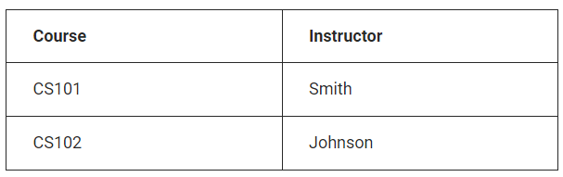
Examples
1] Retrieve details of students who received A grade in CS101.
2] List names of all enrolled students .
3] List the courses that are common to both "Students" and “Instructors“
Notes:
σ(Course = "CS101" AND Grade = "A")(Students)
Π(Name)(Students)
Πcourse[ student intersection instructor]

Slide 14
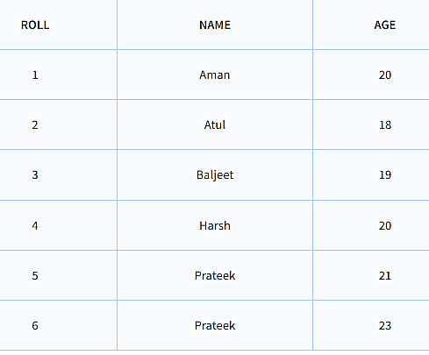
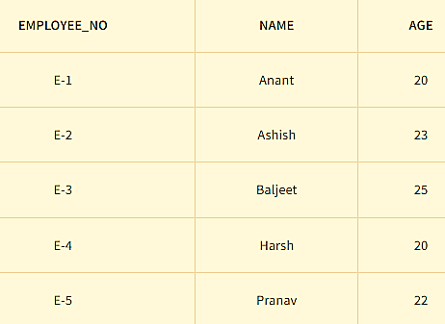
Examples
1] List students whose "AGE" is 20
2] List all the names from STUDENT and EMPLOYEE relation.
3] List students those who are not EMPLOYEE and those who are employee.
Notes:
σ AGE=20 (STUDENT)
∏ NAME(STUDENT) ∪ ∏ NAME(EMPLOYEE)
∏ NAME(STUDENT) - ∏ NAME(EMPLOYEE)

Slide 15
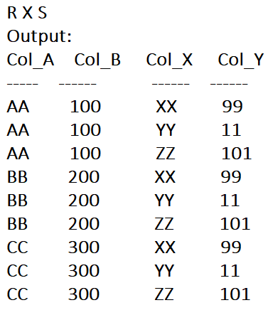
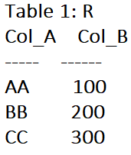
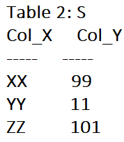
Relational Algebra : Operations
Cartesian product (X): The Cartesian product operation will generate the possible combinations among the tuples from the relations resulting in table containing all the data.
It combines the information of two or more relations in one single relation. Cartesian product is different from union operation and is denoted by “Cross(X)”.

Slide 16
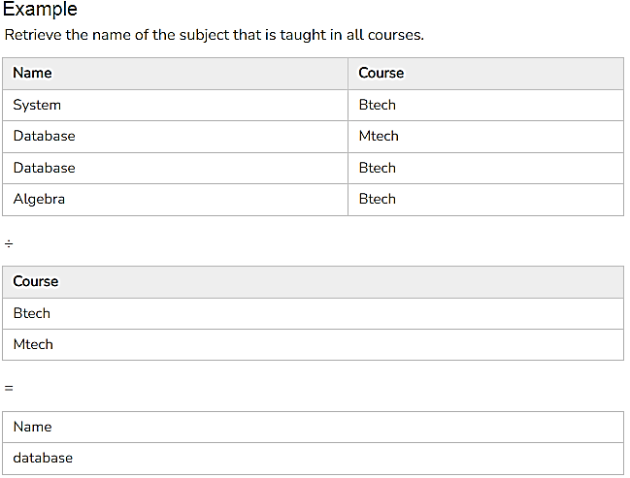
Relational Algebra : Operations
Division Operation(÷) : The division operator is used for queries which involve the ‘all association’.
The Division (÷) operator is used in relational algebra when you need to find entities that are related to all values in a given set. It is useful for queries involving "for all" conditions.
R1 ÷ R2 = tuples of R1 associated with all tuples of R2.
Notes:
Given two relations R(X, Y) and S(Y), where:
R(X, Y) is a relation containing attributes X and Y
S(Y) is a relation containing only attribute Y
The result of R ÷ S gives a relation containing X values that are associated with all values of Y in relation S.

Slide 17
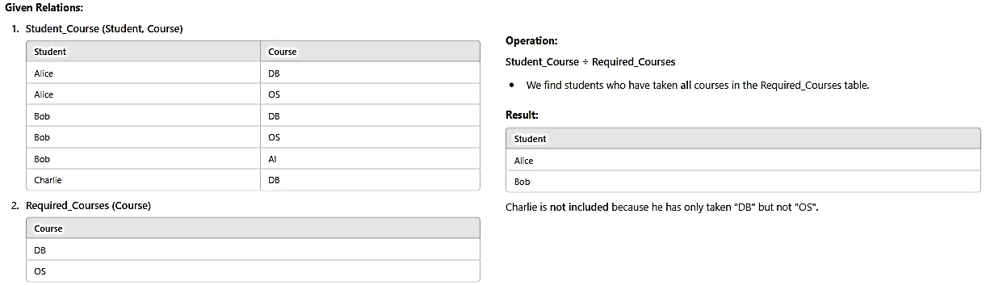

Slide 18
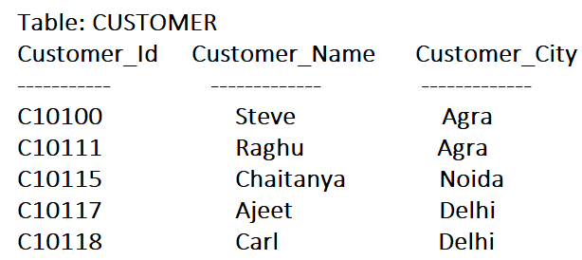
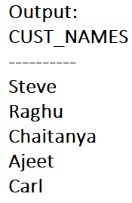
Relational Algebra : Operations
Rename (ρ) : Rename (ρ) operation can be used to rename a relation or an attribute of a relation.
Rename (ρ) Syntax: ρ(new_relation_name, old_relation_name)
Query: ρ(CUST_NAMES, ∏(Customer_Name)(CUSTOMER))

Slide 19
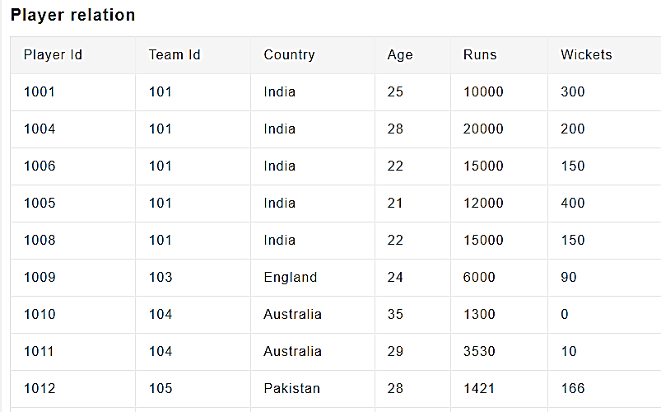
Relational Algebra examples
1. Find Indian player id .
2. List out players those who are having more than 10000 runs.
3. List out player along with their country details having age below 25 and more than 100 wickets.
4. List all the countries in Player relation.
Notes:
ᴨ player_id[σ country=india ](Player)
ᴨ player_id[σ runs>10000 ](Player)
ᴨ player_id,country[σ age>25 and Wickets>100 ](Player)
ᴨ country(player)

Slide 20
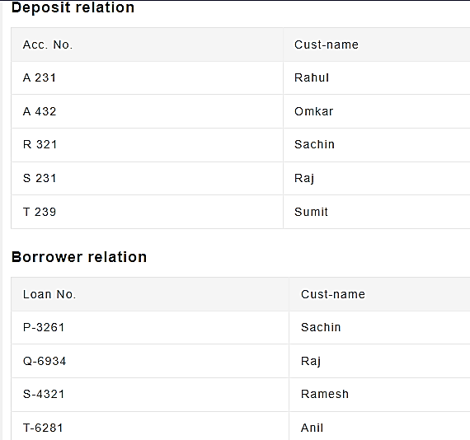
Relational Algebra examples
1. Find all the Customers having an account but not the loan.
2.Change the Name of the deposit relation as “Depositor –details”.
3.Change cust-name attribute of borrower relation as “Customer-Name”.
4. Find customers those who have account and also borrowed loan from a bank.
Π
Notes:
1]πcust-name(Depositor) – πcust-name(Borrower)
2]ƍ(Depositor-details, deposit)
3] ƍ[Customer-Name , π(cust-name) Borrower]
4] π(cust-name) [Deposit ˄ Borrower]

Slide 21
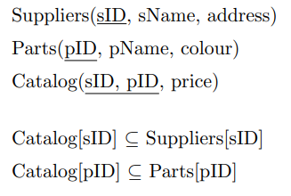
Relational Algebra example
1. Find the names of all red parts.
2.Find all prices for parts that are red or green.
3. Find the sIDs of all suppliers who supply a part that is red or green
Notes:
1 ΠpName(σcolour=“red”P arts)
2 Πprice((σcolour=“red”∨colour=“green”P arts) ./ Catalog)
3 ΠsID((σcolour=“red”∨colour=“green”P arts) ./ Catalog)

Slide 22
Employee (EmpID, Name, Dept, Salary, Age)
Department (DeptID, DeptName, Location)
Project (ProjID, ProjName, DeptID)
WorksOn (EmpID, ProjID, Hours)
Supplier (SuppID, SuppName, City)
Supplies (SuppID, ItemID, Cost)
Item (ItemID, ItemName, Category)
Retrieve the EmpIDs of employees who work on at least one project and are also listed in the employee table.
Retrieve the EmpIDs of employees who are in the Employee table but are not assigned to any project.
Retrieve all employees who work in the "HR" department.
Rename the attribute DeptID of the Department table to Department_Code.
Retrieve the EmpIDs of employees who have worked on all projects.
Retrieve the SuppIDs of suppliers who supply all items in the "Electronics" category.
Notes:
1] πEmpID​(WorksOn)∩πEmpID​(Employee) 6] πSuppID​(Supplies)÷πItemID​(σCategory=′Electronics′​(Item))
2] πEmpID​(Employee)−πEmpID​(WorksOn)
3] σDept=′HR′​(Employee)
5]πEmpID​(WorksOn)÷πProjID​(Project)

Slide 23
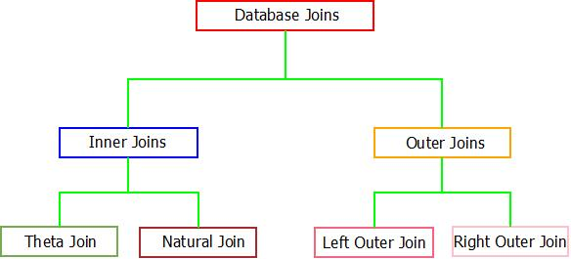
Relational Algebra : Joins
The database joins has the ability of combining two or more data tables into a single table only if the following conditions are satisfied.
There must be a common attribute in both(tables which are participating) tables.
Join condition must be satisfied .
Database joins can be broadly classified into two categories which are further categorized into sub categories.

Slide 24
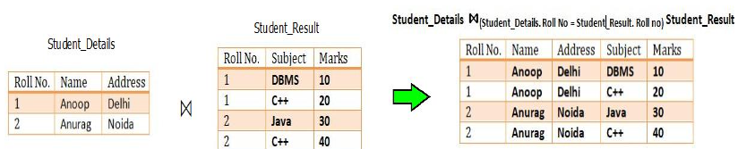
Relational Algebra : Joins (The Inner Joins)
When inner join is applied to tuples or tables, only those tuples of the table are kept which have common attribute in all the tables. Other tuples which are not common are dropped from the resulting tuple/table.
Two possible inner joins are available i.e. Theta Join & Natural Join.
Theta Join :If a condition is satisfied by the participating tables from different relations, then the tuples are combined together using Theta Join. Theta join is denoted through “Theta(Θ)”.
Syntax : R1(X1, X2,X3…Xn) ⋈(Condition “θ”) R2(Y1, Y2,Y3…Yn) where, R1 and R2 are relations having (X1, X2,X3…Xn) and (Y1, Y2,Y3…Yn) as attributes respectively.
For example : Consider the tables Student_Details and Student_Result. Now, if we want to implement theta join on these relations, the result will look like:
Notes:
Inner Join is used to return rows from both tables which satisfy the given condition. It is the most widely used join operation and can be considered as a default join-type. Theta Join allows you to merge two tables based on the condition represented by theta.

Slide 25
Relational Algebra : Joins(Equi Joins)
EQUI Join is done when a Theta join uses only the equivalence condition.
EQUI JOIN creates a JOIN for equality or matching column(s) values of the relative tables.
For example:
A ⋈ _{A.column 2 = B.column 2} (B)
SELECT student.name, student.id, record.class, record.city FROM student JOIN record ON student.city = record.city;

Slide 26
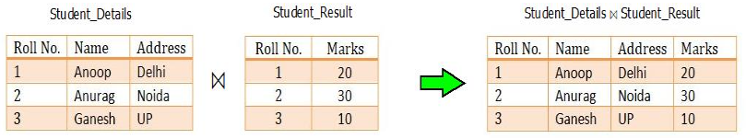
Relational Algebra : Joins (The Inner Joins)
Natural Join (⋈):
Natural join does not supports any condition such as theta join and works only if, one attribute or more than one attributes are common between the joining/participating relations.
Syntax : R1(X1, X2,X3…Xn) ⋈ R2(Y1, Y2,Y3…Yn) where, R1 and R2 are relations having (X1, X2,X3…Xn) and (Y1, Y2,Y3…Yn) as attributes respectively.
For example : Consider the tables Student_Details and Student_Result. Now, if we want to implement natural join on these relations, the result will be
Notes:
A natural join is a type of join operation that creates an implicit join by combining tables based on columns with the same name and data type.

Slide 27
Relational Algebra : Joins (The Outer Joins)
Outer Join (⋈):Outer join overcomes the inability of inner joins of dropping the tuples which are uncommon among participating relations. If we want to display those tuples which are not common, the concept of outer join is used.
Also, if all the tuples needs to be displayed from all the participating relations, outer joins can be used. They are of three types : Left Outer Join, Right Outer Join & Full Outer Join.
Left Outer Join
There exists a concept of position(left or right) of relations in case of both left and right outer join.
In the left outer join, operation allows keeping all tuple in the left relation+ common tuples from both tables.
If in case any tuple in left relation does not matches with the tuple in right relation, NULL value will be displayed against that tuple in the resulting relation.

Slide 28

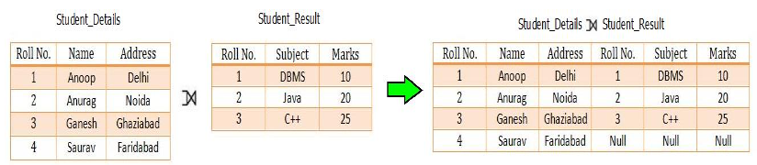
Relational Algebra : Joins (The Outer Joins)
Left Outer Join:
For example : Consider the tables Student_Details and Student_Result. Now, if we want to implement left outer join on these relations, the result will look like:

Slide 29
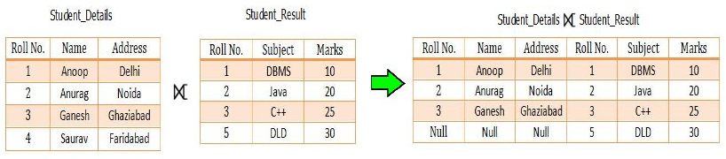
Relational Algebra : Joins (The Outer Joins)
Right Outer Join : In the right outer join, operation allows keeping all tuple in the right relation.
However, if there is no matching tuple is found in the left relation, then the attributes of the left relation in the join result are filled with null values.
For example : Consider the tables Student_Details and Student_Result. Now, if we want to implement right outer join on these relations, the result will look like:

Slide 30
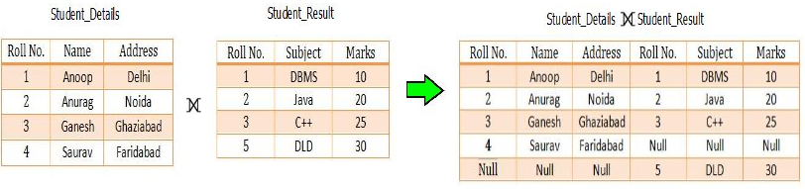
Relational Algebra : Joins (The Outer Joins)
Full Outer Join : In a full outer join, all tuples from both relations are included in the result, irrespective of the matching condition.
If in case, tuples doesn’t matches, NULL value is passes against that.
For example : Consider the tables Student_Details and Student_Result. Now, if we want to implement full outer join on these relations, the result will look like:

Slide 31
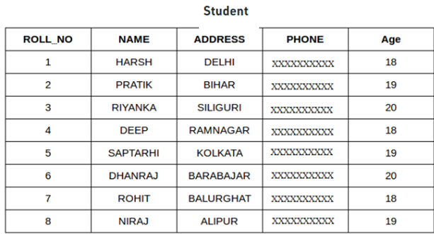
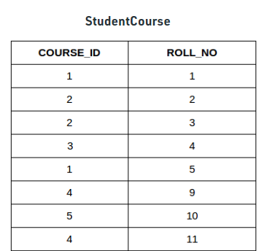
1] List the names and age of students enrolled in different courses.
2]Identify names of all students those who are admitted and not enrolled for courses.
3] Identify names of enrolled students along with their course details , those who belong to Bihar.
4] Retrieve Student Details Along with Their Courses
5] Retrieve Course IDs Along with the Names of Enrolled Students
Notes:
1] select student.name, student.age from student inner join studentcourse on student.rollno=studentcourse.rollno;
2]select name from student;
3]select student.name ,student.addressstudentcourse.course_id from student,studentcourse on student.rollno=studentcourse.rollno and student.address=“bihar”;
4] SELECT S.ROLL_NO, S.NAME, S.ADDRESS, S.AGE, SC.COURSE_ID FROM Student S JOIN StudentCourse SC ON S.ROLL_NO = SC.ROLL_NO;
5] SELECT SC.COURSE_ID, S.NAME FROM StudentCourse SC JOIN Student S ON SC.ROLL_NO = S.ROLL_NO;

Slide 32
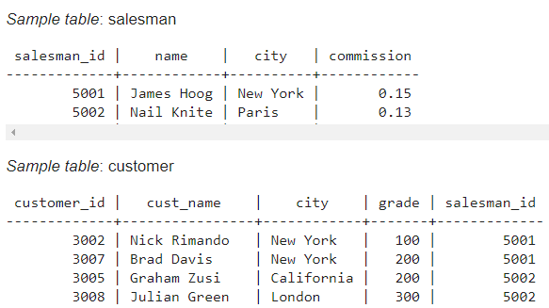
1] write a SQL query to find the salesperson and customer who reside in the same city. Return Salesman, cust_name and city.
2]Identify salesman who delivered orders to multiple customer.
Notes:
SELECT salesman.name AS "Salesman", customer.cust_name, customer.city FROM salesman WHERE salesman.city = customer.city;
Select c1.salesmanid from customer as 1, customer as c2 where c1.salesman_id=c2.salesmanid and c1.customer_id<>c2.customer_id;

Slide 33
Relational Algebra:Summary
Operation (Symbols) | Purpose
Select(σ) | The SELECT operation is used for selecting a subset of the tuples according to a given selection condition
Projection(π) | The projection eliminates all attributes of the input relation but those mentioned in the projection list.
Union Operation(∪) | UNION is symbolized by symbol. It includes all tuples that are in tables A or in B.
Set Difference(-) | The result of A – B, is a relation which includes all tuples that are in A but not in B.
Intersection(∩) | Intersection defines a relation consisting of a set of all tuple that are in both A and B.
Cartesian Product(X) | Cartesian operation is helpful to merge columns from two relations.
Inner Join | Inner join, includes only those tuples that satisfy the matching criteria.
Theta Join(θ) | The general case of JOIN operation is called a Theta join. It is denoted by symbol θ.
EQUI Join | When a theta join uses only equivalence condition, it becomes a equi join.
Natural Join(⋈) | Natural join can only be performed if there is a common attribute between the relations.
Outer Join | In an outer join, along with tuples that satisfy the matching criteria.
Left Outer Join( ) | In the left outer join, operation allows keeping all tuple in the left relation.
Right Outer join( ) | In the right outer join, operation allows keeping all tuple in the right relation.
Full Outer Join( ) | In a full outer join, all tuples from both relations are included in the result irrespective of the matching condition.

Slide 34
Joins Vs Views
Feature | Joins | Views
What it is | A query operation combining tables | A virtual table (stored query)
Storage | Not stored, only executed when run | Stored in DB metadata
Reusability | Must be written every time | Can reuse by calling the view name
Security | Exposes all joined data | Can hide sensitive columns from users
Performance | Executes at query runtime | May improve readability but still runs underlying query
Example usage | To combine tables on the fly | To simplify and standardize frequent queries

Slide 35
Joins vs views
When to use JOINs:
You need data from multiple tables just for one query/report.
You want to filter, group, or aggregate data across related tables.
You don’t need to reuse the same combination often.
You want real-time results directly from base tables.
When to use Views:
You frequently need the same JOIN or complex query → save it as a view.
You want to simplify queries for end users (hide complexity).
You want to restrict access (e.g., give access to a view instead of base tables for security).
You need consistent logic reused in many places (e.g., business calculations).
You want a read-only layer for reporting tools.

Slide 36
What is SQL?
SQL stands for Structured Query Language. It is used for storing and managing data in relational database management system (RDMS).
It is a standard language for Relational Database System. It enables a user to create, read, update and delete relational databases and tables.
All the RDBMS like MySQL, Informix, Oracle, MS Access and SQL Server use SQL as their standard database language.
SQL allows users to query the database in a number of ways, using English-like statements.

Slide 37
SQL Datatype
SQL Datatype is used to define the values that a column can contain.
Every column is required to have a name and data type in the database table.
Data type | Description
char | It has a maximum length of 8000 characters. It contains Fixed-length non-unicode characters.
varchar | It has a maximum length of 8000 characters. It contains variable-length non-unicode characters.
text | It has a maximum length of 2,147,483,647 characters. It contains variable-length non-unicode characters.
Datatype | Description
date | It is used to store the year, month, and days value.
time | It is used to store the hour, minute, and second values.
timestamp | It stores the year, month, day, hour, minute, and the second value.
Notes:
Char is a datatype in SQL which is used to store character string of fixed length specified. If the length of the string is less than set or fixed-length then it is padded with extra blank spaces so that its length became equal to the set length when PAD_CHAR_TO_FULL_LENGTH SQL mode is enabled. The storage size of the CHAR datatype is n bytes(set length). We should use this datatype when we expect the data values in a column are of the same length.
Varchar is a datatype in SQL which is used to store character string of variable length but a maximum of the set length specified. If the length of the string is less than set or fixed-length then it will store as it is without padded with extra blank spaces.

Slide 38
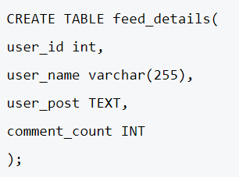
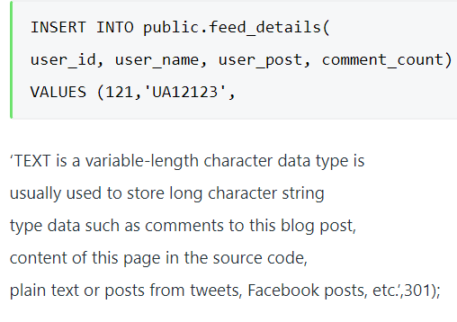
SQL Text Data type example
Notes:
VARBINARY(MAX) – for storing image in sqlserver
TINYTEXTHolds a string with a maximum length of 255 charactersTEXT(size)Holds a string with a maximum length of 65,535 bytes
Varchar stores Non-unicode or English character data types, and it can contain a maximum of 8000 characters. It only supports ASCII values. Nvarchar stores Unicode or Non-English character data types, and it can contain a maximum of 4000 characters. It supports ASCII values as well as special characters.
UNICODE is an international standard character set. The UNICODE character set provides a unique representation for all characters used in alphabets

Slide 39
SQL Datatype
Data type | Description
int | It is used to specify an integer value.
smallint | It is used to specify small integer value.
bit | It has the number of bits to store.
decimal | It specifies a numeric value that can have a decimal number.
numeric | It is used to specify a numeric value.
Notes:
The SMALLINT data type stores small whole numbers that range from –32,767 to 32,767.
bigint-9,223,372,036,854,775,808 to 9,223,372,036,854,775,807-2^63 to 2^63-1 8 Bytes
int-2,147,483,648 to 2,147,483,647-2^31 to 2^31-1 4 Bytes
smallint-32,768 to 32,767-2^15 to 2^15-1 2 Bytes
tinyint0 to 2552^0-1 to 2^8-1 1 Byte

Slide 40
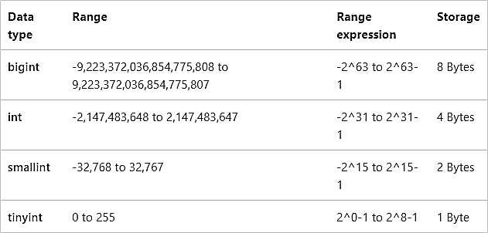
CREATE TABLE MyTable ( MyBigIntColumn BIGINT ,MyIntColumn INT ,MySmallIntColumn SMALLINT ,MyTinyIntColumn TINYINT );
INSERT INTO MyTable VALUES (9223372036854775807, 2147483647,32767,255);
Notes:
Decimal/ Numeric can have up to 17 bytes size.
The IMAGE data type in SQL Server has been used to store the image files. Recently, Microsoft began suggesting using VARBINARY(MAX) instead of IMAGE for storing
CREATE TABLE Images ( ImageID INT AUTO_INCREMENT PRIMARY KEY, ImageName VARCHAR(255), ImageData LONGBLOB );
LONGBLOB is used to store large binary data (up to 4GB). You can also use BLOB, MEDIUMBLOB, or TINYBLOB depending on size requirements.
a large amount of data in a single column since IMAGE will be retired in a future version of MS SQL Server
INSERT INTO Images (ImageName, ImageData) VALUES ('example.jpg', LOAD_FILE('/path/to/image.jpg'));

Slide 41
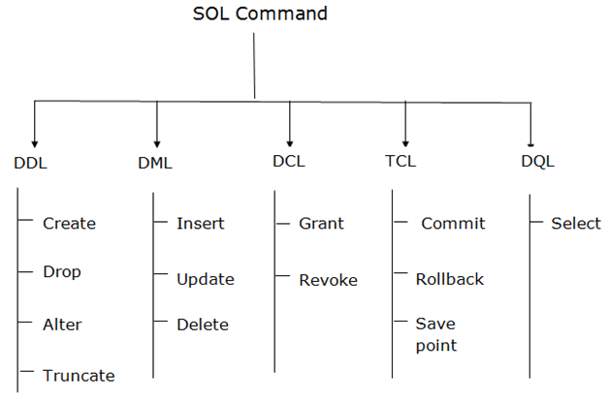
SQL Commands
SQL commands are instructions. It is used to communicate with the database. It is also used to perform specific tasks, functions, and queries of data.
SQL can perform various tasks like create a table, add data to tables, drop the table, modify the table, set permission for users.

Slide 42
SQL Commands
Comments in SQL
Single-Line Comments
The single line comment starts with two hyphens (–). So, any text mentioned after (–), till the end of a single line will be ignored by the compiler.
Example:
--Select all:
SELECT * FROM Employee_Info;
Multi-Line Comments
The Multi-line comments start with /* and end with */. So, any text mentioned between /* and */ will be ignored by the compiler.
Example:
/*Select all the columns
of all the records
from the Employee_Info table:*/
SELECT * FROM Students;
Data Definition Language(DDL) – Consists of commands which are used to define the database.
Data Manipulation Language(DML) – Consists of commands which are used to manipulate the data present in the database.
Data Control Language(DCL) – Consists of commands which deal with the user permissions and controls of the database system.
Transaction Control Language(TCL) – Consist of commands which deal with the transaction of the database.

Slide 43
Data Definition Language (DDL)
DDL changes the structure of the table like creating a table, deleting a table, altering a table, etc.
All the command of DDL are auto-committed that means it permanently save all the changes in the database.
Here are some commands that come under DDL:
CREATE
ALTER
DROP
TRUNCATE
TRUNCATE: It is used to delete all the rows from the table and free the space containing the table.
TRUNCATE TABLE table_name;
TRUNCATE TABLE EMPLOYEE;
DROP: It is used to delete both the structure and record stored in the table.
DROP TABLE table_name;
DROP TABLE EMPLOYEE;

Slide 44
Data Definition Language (DDL)
CREATE It is used to create a new table in the database.
CREATE TABLE TABLE_NAME (COLUMN_NAME DATATYPES[,....]);
CREATE TABLE EMPLOYEE(Name VARCHAR2(20), Email VARCHAR2(100), DOB DATE);
You can also create a table using another table.
Syntax:
CREATE TABLE NewTableName AS
SELECT Column1, column2,..., ColumnN
FROM ExistingTableName
WHERE ....;
Example:
CREATE TABLE ExampleTable AS
SELECT Emp_Name, Phone_Num
FROM Employee_Info;

Slide 45
Data Definition Language (DDL)
ALTER: It is used to alter the structure of the database. This change could be either to modify the characteristics of an existing attribute or probably to add a new attribute.
ALTER TABLE table_name ADD column_name COLUMN-definition;
ALTER TABLE table_name MODIFY(column_definitions....);
ALTER TABLE STU_DETAILS ADD(ADDRESS VARCHAR2(20));
ALTER TABLE STU_DETAILS MODIFY (NAME VARCHAR2(20));
SQL Commands: Constraints Used In Database
Constraints are used in a database to specify the rules for data in a table. The following are the different types of constraints:
NOT NULL :This constraint ensures that a column cannot have a NULL value.
UNIQUE: This constraint ensures that all the values in a column are unique.
CHECK: This constraint ensures that all the values in a column satisfy a specific condition.
DEFAULT: This constraint consists of a set of default values for a column when no value is specified.

Slide 46
Data Definition Language (DDL)
--UNIQUE on Create Table
CREATE TABLE Employee_Info
(
EmployeeID int NOT NULL UNIQUE,
EmployeeName varchar(255) NOT NULL,
Emergency ContactName varchar(255),
PhoneNumber int NOT NULL,
Address varchar(255),
City varchar(255),
Country varchar(255)
);
--UNIQUE on ALTER TABLE
ALTER TABLE Employee_Info
ADD UNIQUE (Employee_ID);
--NOT NULL on Create Table
CREATE TABLE Employee_Info
(
EmployeeID int NOT NULL,
EmployeeName varchar(255) NOT NULL,
Emergency ContactName varchar(255),
PhoneNumber int NOT NULL,
Address varchar(255),
City varchar(255),
Country varchar(255)
);
--NOT NULL on ALTER TABLE
ALTER TABLE Employee_Info
MODIFY PhoneNumber int NOT NULL;

Slide 47
Data Definition Language (DDL)
--DEFAULT Constraint on CREATE TABLE
CREATE TABLE Employee_Info
(
EmployeeID int NOT NULL,
EmployeeName varchar(255),
Emergency ContactName varchar(255),
PhoneNumber int,
Address varchar(255),
City varchar(255),
Country varchar(255) DEFAULT 'India'
);
--DEFAULT Constraint on ALTER TABLE
ALTER TABLE Employee_Info
ADD CONSTRAINT defau_Country
DEFAULT 'India' FOR Country;
--CHECK Constraint on CREATE TABLE
CREATE TABLE Employee_Info
(
EmployeeID int NOT NULL,
EmployeeName varchar(255),
Emergency ContactName varchar(255),
PhoneNumber int,
Address varchar(255),
City varchar(255),
Country varchar(255) CHECK (Country=='India')
);
--CHECK Constraint on ALTER TABLE
ALTER TABLE Employee_Info
ADD CHECK (Country=='India');

Slide 48
Data Manipulation Language
DML commands are used to modify the database. It is responsible for all form of changes in the database.
The command of DML is not auto-committed that means it can't permanently save all the changes in the database. They can be rollback.
INSERT
UPDATE
DELETE
SELECT
INSERT: The INSERT statement is a SQL query. It is used to insert data into the row of a table.
INSERT INTO TABLE_NAME (col1, col2, col3,.... col N) VALUES (value1, value2, value3, .... valueN);
INSERT INTO TABLE_NAME VALUES (value1, value2, value3, .... valueN);
INSERT INTO book (Author, Subject) VALUES (“ABC", "DBMS");

Slide 49
Data Manipulation Language
UPDATE: This command is used to update or modify the value of a column in the table.
UPDATE table_name SET [column_name1= value1,...column_nameN = valueN] [WHERE CONDITION]
UPDATE students SET User_Name = ’XYZ' WHERE Student_Id = '3’
DELETE: It is used to remove one or more row from a table.
DELETE FROM table_name [WHERE condition];
DELETE FROM book WHERE Author=“ABC";

Slide 50
Data Manipulation Language
Example:
SELECT EmployeeID, EmployeeName
FROM Employee_Info;
--(*) is used to select all from the table
SELECT * FROM Employee_Info;
-- To select the number of records to return use:
SELECT TOP 3 * FROM Employee_Info;
you can use the following keywords with the SELECT statement:
DISTINCT
ORDER BY
GROUP BY
HAVING Clause
INTO
SELECT
This statement is used to select data from a database and the data returned is stored in a result table, called the result-set.
Syntax
SELECT Column1, Column2, ...ColumN
FROM TableName;
--(*) is used to select all from the table
SELECT * FROM table_name;
-- To select the number of records to return use:
Notes:
Before grouping you can use where clause and after grouping you can use having clause.

Slide 51
Data Manipulation Language
Example:
-- Select all employees from the 'Employee_Info' table sorted by EmergencyContactName:
SELECT * FROM Employee_Info
ORDER BY EmergencyContactName;
-- Select all employees from the 'Employee_Info' table sorted by EmergencyContactName in Descending order:
SELECT * FROM Employee_Info
ORDER BY EmergencyContactName DESC;
The ‘SELECT DISTINCT’ Statement
This statement is used to return only different values.
Syntax:SELECT DISTINCT Column1, Column2, ...ColumnN
FROM TableName;
Example SELECT DISTINCT PhoneNumber FROM Employee_Info;
The ‘ORDER BY’ Statement
The ‘ORDER BY’ statement is used to sort the required results in ascending or descending order. The results are sorted in ascending order by default.
Syntax: SELECT Column1, Column2, ...ColumnN
FROM TableName
ORDER BY Column1, Column2, ... ASC|DESC;

Slide 52
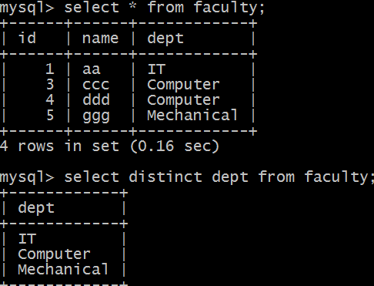
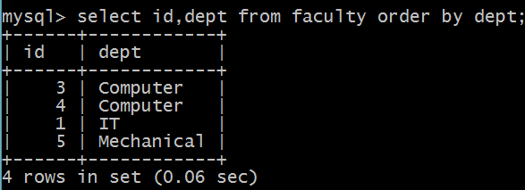
Examples

Slide 53
Data Manipulation Language
The ‘HAVING’ Clause
The ‘HAVING’ clause is used in SQL because the WHERE keyword cannot be used everywhere.
Syntax :SELECT ColumnName(s)
FROM TableName
WHERE Condition
GROUP BY ColumnName(s)
HAVING Condition
ORDER BY ColumnName(s);
Example
/* To list the number of employees in each city. The employees should be sorted high to low and only those cities must be included who have more than 5 employees:*/
SELECT COUNT(EmployeeID), City
FROM Employee_Info
GROUP BY City
HAVING COUNT(EmployeeID) > 2
ORDER BY COUNT(EmployeeID) DESC;
The ‘GROUP BY’ Statement
This ‘GROUP BY’ statement is used with the aggregate functions to group the result-set by one or more columns.
Syntax :SELECT Column1, Column2,..., ColumnN
FROM TableName
WHERE Condition
GROUP BY ColumnName(s)
ORDER BY ColumnName(s);
Example
-- To list the number of employees from each city.
SELECT COUNT(EmployeeID), City
FROM Employee_Info
GROUP BY City;
Notes:
aggregate functions like COUNT, SUM, MIN, MAX, AVG. In SQL, aggregate functions let you perform a calculation on multiple data and return a single value. we have concluded that WHERE is used to filter records before any groupings take place that is on single rows, GROUP BY aggregates/ groups the rows and returns the summary for each group and HAVING is used to filter values after they have been grouped.

Slide 54
WHERE | HAVING
It is used to filter data directly on the table. | It is used to filter the data of groups created on a table.
It is applied as a row operation. | It is applied as a column operation.
The WHERE clause pulls only the filter data based on condition. | The HAVING clause fetches all data before applying the filter condition.
You cannot use aggregate functions on the WHERE condition. | It is used on aggregate function on which group has performed.

Slide 55
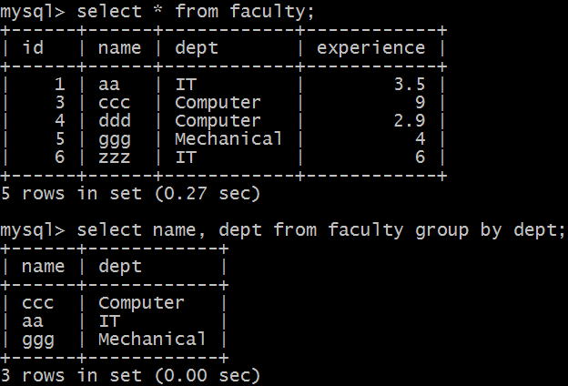
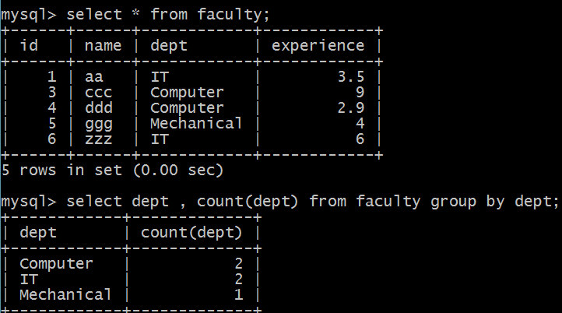
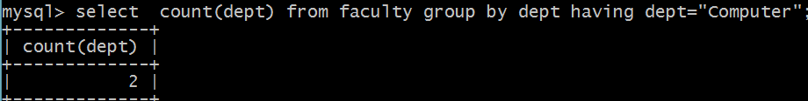
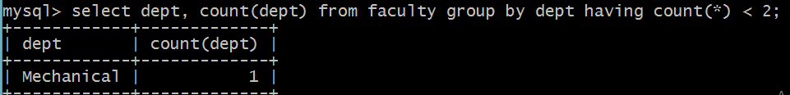
Examples
Notes:
The GROUP BY statement is often used with aggregate functions (COUNT(), MAX(), MIN(), SUM(), AVG()) to group the result-set by one or more columns.
write a query to get count of faculty in each department having expereince<5
SELECT dept, COUNT(*) AS faculty_count
FROM faculty
WHERE experience < 5
GROUP BY dept;

Slide 56
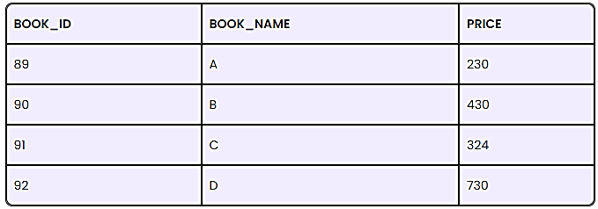
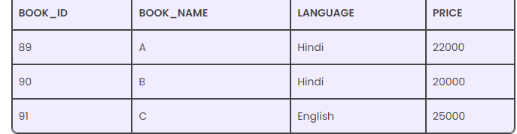
Having and Where Clause Example
List the book details whose price is less than 350 [Table 1]
Identify language and count number of books for the language having multiple books.
Notes:
1) SELECT BOOK_ID, PRICE FROM BOOKS WHERE PRICE > 350
2)SELECT COUNT(BOOK_ID), LANGUAGEFROM BOOKS
GROUP BY LANGUAGE HAVING COUNT(LANGUAGE) > 1;

Slide 57
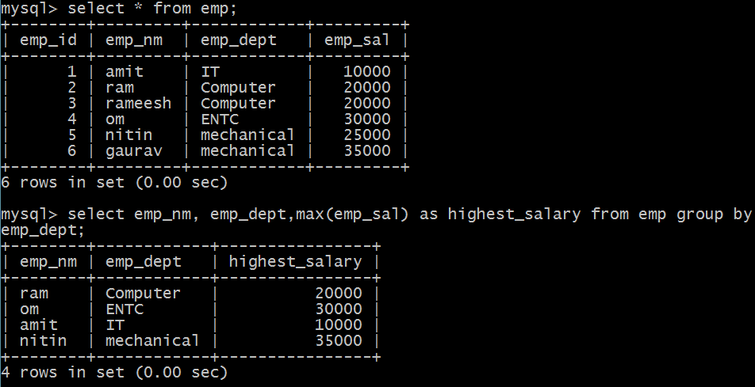

Slide 58
Aggregate Functions
Example
SELECT MIN(EmployeeID) AS SmallestID
FROM Employee_Info;
MAX() Function
The MAX function returns the largest value of the selected column in a table.
Syntax
SELECT MAX(ColumnName)
FROM TableName
WHERE Condition;
Example
SELECT MAX(Salary) AS LargestFees
FROM Employee_Salary;
An aggregate function in SQL performs a calculation on multiple values and returns a single value.
SQL provides many aggregate functions that include avg, count, sum, min, max, etc.
An aggregate function ignores NULL values when it performs the calculation, except for the count function.
MIN() Function
The MIN function returns the smallest value of the selected column in a table.
Syntax
SELECT MIN(ColumnName)
FROM TableName
WHERE Condition;

Slide 59
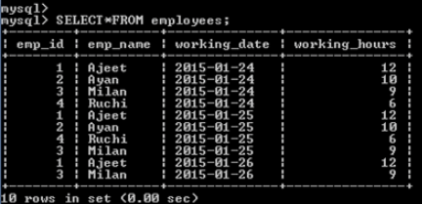

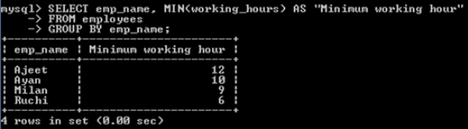

Slide 60
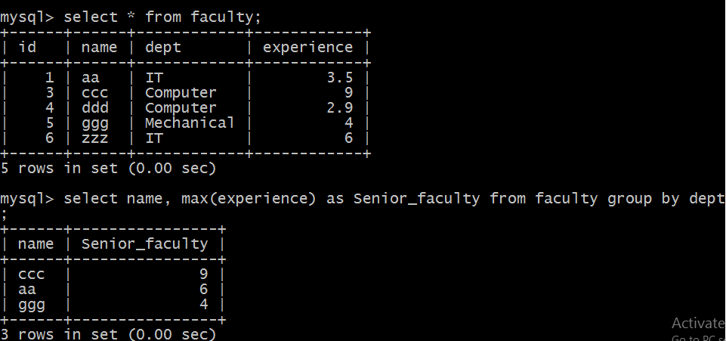

Slide 61
Aggregate Functions
Example
SELECT SUM(Salary)
FROM Employee_Salary;
AVG() Function
The AVG function returns the average value of a numeric column that you choose.
Syntax SELECT AVG(ColumnName)
FROM TableName WHERE Condition;
Example
SELECT AVG(Salary) FROM Employee_Salary;
COUNT() Function
The COUNT function returns the number of rows which match the specified criteria.
Syntax: SELECT COUNT(ColumnName) FROM TableName
WHERE Condition;
Example
SELECT COUNT(EmployeeID)
FROM Employee_Info;
SUM() Function
The SUM function returns the total sum of a numeric column that you choose.
Syntax: SELECT SUM(ColumnName) FROM TableName WHERE Condition;

Slide 62
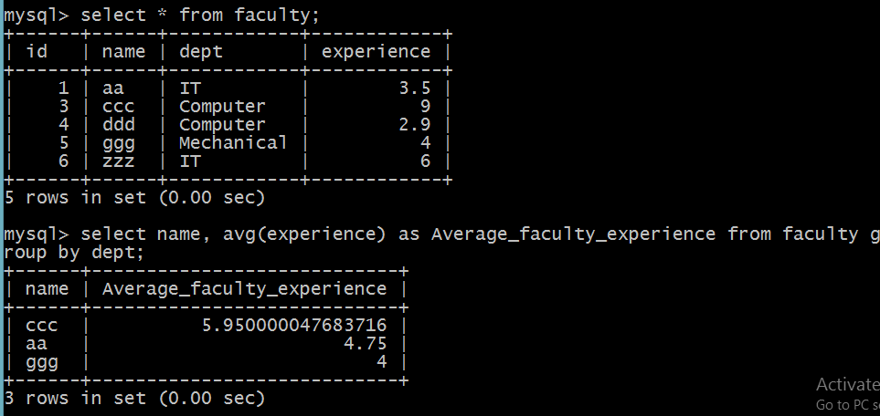

Slide 63
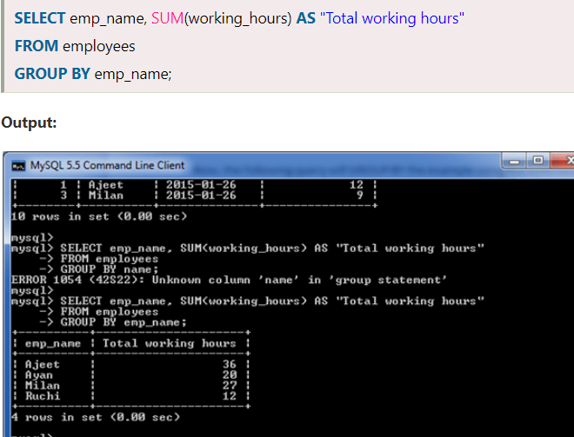

Slide 64

Group by -aggregate example
Notes:
Select country,count(*) as no_of_customers from customers group by country.

Slide 65
SQL Commands: Set Operations
The SET Operators in MySQL are basically used to combine the result of more than 1 select statement and return the output as a single result set. In SQL, 4 types of set operators are. They are as follows:
UNION: It is used to combine two or more result sets into a single set, without duplicates.
UNION ALL: It is used to combine two or more result sets into a single set, including duplicates.
INTERSECT: It is used to combine two result sets and returns the data which are common in both the result set.
EXCEPT/MINUS: It is used to combine two result sets and returns the data from the first result set which is not present in the second result set.
Points to Remember while working with Set Operations:
Every SELECT statement involved in the query must have a similar number of columns.
The columns in the SELECT statement must be in the same order and have similar data types.
In order to sort the result, an ORDER BY clause should be part of the last select statement. The column names or aliases must be found out by the first select statement.

Slide 66
SQL Commands: Set Operations
Examples to understand SET Operators in MySQL: We are going to use EmployeeUK and EmployeeUSA tables to understand the SET Operators in MySQL.
CREATE DATABASE EmployeeDB;
USE EmployeeDB;
CREATE TABLE EmployeeUK
(
EmployeeId INT PRIMARY KEY,
FirstName VARCHAR(50),
LastName VARCHAR(50),
Gender VARCHAR(10),
Department VARCHAR(20)
);
INSERT INTO EmployeeUK VALUES(1, 'Pranaya', 'Rout', 'Male','IT');
INSERT INTO EmployeeUK VALUES(2, 'Priyanka', 'Dewangan', 'Female','IT');
INSERT INTO EmployeeUK VALUES(3, 'Preety', 'Tiwary', 'Female','HR');
INSERT INTO EmployeeUK VALUES(4, 'Subrat', 'Sahoo', 'Male','HR');
INSERT INTO EmployeeUK VALUES(5, 'Anurag', 'Mohanty', 'Male','IT');
INSERT INTO EmployeeUK VALUES(6, 'Rajesh', 'Pradhan', 'Male','HR');
INSERT INTO EmployeeUK VALUES(7, 'Hina', 'Sharma', 'Female','IT');
CREATE TABLE EmployeeUSA
(
EmployeeId INT PRIMARY KEY,
FirstName VARCHAR(50),
LastName VARCHAR(50),
Gender VARCHAR(10),
Department VARCHAR(20)
);
INSERT INTO EmployeeUSA VALUES(1, 'James', 'Pattrick', 'Male','IT');
INSERT INTO EmployeeUSA VALUES(2, 'Priyanka', 'Dewangan', 'Female','IT');
INSERT INTO EmployeeUSA VALUES(3, 'Sara', 'Taylor', 'Female','HR');
INSERT INTO EmployeeUSA VALUES(4, 'Subrat', 'Sahoo', 'Male','HR');
INSERT INTO EmployeeUSA VALUES(5, 'Sushanta', 'Jena', 'Male','HR');
INSERT INTO EmployeeUSA VALUES(6, 'Mahesh', 'Sindhey', 'Female','HR');
INSERT INTO EmployeeUSA VALUES(7, 'Hina', 'Sharma', 'Female','IT');

Slide 67


SQL Commands: Set Operations
UNION ALL Operator in MySQL
The UNION ALL operator is used to combine the result set of two or more SELECT statements into a single result including the duplicate values.
SELECT FirstName, LastName, Gender, Department FROM EmployeeUK
UNION ALL
SELECT FirstName, LastName, Gender, Department FROM EmployeeUSA;
Here we got all the 14 rows in the result set.
UNION Operator in MySQL
The UNION operator is used to combine the result set of two or more SELECT statements into a single result set by removing the duplicate records. That means the UNION Operator selects only the distinct values.
SELECT FirstName, LastName, Gender, Department FROM EmployeeUK
UNION
SELECT FirstName, LastName, Gender, Department FROM EmployeeUSA;
Here we don’t have any duplicate data. Here, in the result set, we got a total of 11 rows out of 14 rows. This is because 3 rows are present in both the result set.

Slide 68


SQL Commands: Set Operations
MySQL EXCEPT Operator:
The EXCEPT operator is used to combine two tables or two result sets and will return rows from the first select statement that are not present in the second select statement.
But, the EXCEPT Operator is not supported by MYSQL. We can achieve the EXCEPT Operator functionality in MySQL using the following ways.
Using NOT IN Operator to achieve EXCEPT functionality:
Here, we are checking the FirstName column value only. Following is the SQL Query using the NOT IN Operator which returns the employees from the first EmployeeUK table that are not present in the EmployeeUSA table.
INTERSECT Operator in MySQL
The INTERSECT operator is used to combine two result sets and returns the data which are common in both the result set.
But the INTERSECT Operator is not supported by MYSQL. We can achieve the INTERSECT Operator functionality in MySQL using the following ways.
Using IN Operator to achieve INTERSECT functionality:
Here, we are checking the FirstName column value only. Following is the SQL Query using the IN Operator which returns the common employees i.e. the employees which are present in both t EmployeeUK and EmployeeUSA tables. Here, we are checking common based on the First Name column value.
SELECT * FROM EmployeeUK
WHERE FirstName IN (SELECT FirstName FROM EmployeeUSA);

Slide 69
Date Functions in SQL
CURRENT_TIMESTAMP() Function
CURRENT_TIMESTAMP() function returns the current system timestamp.
SELECT CURRENT_TIMESTAMP AS CurrentServerDateTime;
DATE_ADD() Function
DATE_ADD() function adds a number to a datepart and returns the modified datetime value. The following example adds 1 day to the specified date
SELECT DATE_ADD('2022/10/01',interval 1 day) AS Result; -- 2022-10-02
DATEDIFF(expr1,expr2)
DATEDIFF() returns expr1 − expr2 expressed as a value in days from one date to the other. expr1 and expr2 are date or date-and-time expressions.
SELECT DATEDIFF('2022/10/01','2022/09/25’); --6
Notes:
The DATEDIFF() function returns the number of days between two date values.
The DATE_ADD() function adds a time/date interval to a date and then returns the date.

Slide 70




Slide 71
String Functions in SQL
ASCII(str): Returns the numeric value of the leftmost character of the string str. Returns 0 if str is the empty string. Returns NULL if str is NULL. ASCII() works for 8-bit characters.
SELECT ASCII('A’); --65
INSERT(str,pos,len,newstr) :Returns the string str, with the substring beginning at position pos and len characters long replaced by the string newstr.
SELECT INSERT('Quadratic', 3, 4, 'What’); ---QuWhattic
INSTR(str,substr) : Returns the position of the first occurrence of substring substr in string str.
SELECT INSTR('foobarbar', 'bar’); -- 4
select LCASE('CoLleGe’); ---- college
select Length('vit’); --3

Slide 72

Nested queries in SQL
Nested queries are those queries which have an outer query and inner subquery.
So, basically, the subquery is a query which is nested within another query such as SELECT, INSERT, UPDATE or DELETE.
SQL subqueries or nested queries are SQL statements where we need the results from our database after using multiple filters.
SELECT column_name
FROM table_name1
WHERE VALUE IN
(SELECT column_name
FROM table_name2
WHERE condition)

Slide 73
Nested queries in SQL
Rules to Use Subqueries in SQL
Subqueries need to be enclosed in the Where clause and can be used with Insert, Update, Delete, and Select statements.
We can use comparison operators for example: <, >, > =, < =, !=, IN , Between for the subqueries.
The subquery is always executed first and then the main query.
Subquery should be enclosed within parentheses.
Subqueries are always to the right of the comparison operators.
We can’t use Order By clause in the subquery; instead, we can use the Group By clause.
We can’t use Between clause with a subquery, but we can use Between in a subquery.

Slide 74
Nested queries in SQL
Update Statement with Subquery
Example 2: Let us increase the salary of Senior Manager to 35000.
UPDATE EMP AS E, (SELECT EmployeeID FROM emp WHERE post='Sr.Manager') AS P
SET E.salary=35000
WHERE E.EmployeeID = P.EmployeeID;
SELECT Statement with Subquery
Example 1: Let us find the second highest salary of the employee in emp
SELECT emp_id, MAX(salary) AS salary
FROM emp
WHERE salary < (SELECT MAX(salary)
FROM emp);

Slide 75

Finding second highest salary through nested query

Slide 76


Slide 77

Nested Query Examples
Identify list of employee having salary >4500.
Update salary of an employee with 0.25% whose age is greater than or equal to 29.
Notes:
SELECT *
FROM EMPLOYEE
WHERE ID IN (SELECT ID
FROM EMPLOYEE
WHERE SALARY > 4500);
2) UPDATE EMPLOYEE
SET SALARY = SALARY * 0.25
WHERE AGE IN (SELECT AGE FROM CUSTOMERS_BKP
WHERE AGE >= 29);

Slide 78

Co-related Nested Queries/Correlated Sub query
In co-related nested queries, the output of inner query depends on the row which is being currently executed in outer query.
Correlated sub queries are used for row-by-row processing. Each sub query is executed once for every row of the outer query. That is The subquery is executed repeatedly for each row of the outer query, using the values from the current row to perform the subquery.
In other words, the inner query is driven by the outer query.

Slide 79

Exists and Not exist keyword
Using EXISTS condition with SELECT statement To fetch the first and last name of the customers who placed atleast one order.
Using EXISTS condition with DELETE statement Delete the record of all the customer from Order Table whose last name is ‘Mehra’.
Using EXISTS condition with UPDATE statement Update the lname as ‘Kumari’ of customer in Customer Table whose customer_id is 401.
Notes:
SELECT fname, lname FROM Customers WHERE EXISTS (SELECT * FROM Orders WHERE Customers.customer_id = Orders.c_id);
DELETE FROM Orders WHERE EXISTS (SELECT * FROM customers WHERE Customers.customer_id = Orders.c_id AND Customers.lname = 'Mehra');
Update customer set lname=“kumari” where exists(select * from customer where customer_id=401)

Slide 80
Feature | Nested Query | Correlated Sub query
Execution | Runs once, result used by outer query | Runs for each row of the outer query
Dependency | Independent of the outer query | Dependent on the outer query
Performance | Generally faster | Can be slow for large datasets
Use Cases | Filtering, comparison, finding max/min values | Row-by-row comparisons, filtering based on row-specific conditions

Slide 81


Data Control Language
DCL commands are used to grant and take back authority from any database user.
Here are some commands that come under DCL:
Grant
Revoke
Grant: It is used to give user access privileges to a database.
Example GRANT SELECT, UPDATE ON MY_TABLE TO SOME_USER, ANOTHER_USER;
Revoke: It is used to take back permissions from the user.
Example REVOKE SELECT, UPDATE ON MY_TABLE FROM USER1, USER2;
Notes:
A Data Control Language is a syntax similar to a computer programming language used to control access to data stored in a database (Authorization).
SELECT CURRENT_USER();=➔ TO check current user.
GRANT privileges_names ON object TO user; Ex:GRANT SELECT, INSERT, DELETE, UPDATE ON Users TO 'Amit'@'localhost;
The GRANT command is used for permitting the users whereas the REVOKE command is used for removing the authorization.

Slide 82
Transaction Control Language
TCL commands can only use with DML commands like INSERT, DELETE and UPDATE only.
Here are some commands that come under TCL:
COMMIT
ROLLBACK
SAVEPOINT
Commit: Commit command is used to save all the transactions to the database.
Syntax: COMMIT;
DELETE FROM CUSTOMERS
WHERE AGE = 25;
COMMIT;

Slide 83
Transaction Control Language
Rollback: Rollback command is used to undo transactions that have not already been saved to the database.
Syntax: ROLLBACK;
DELETE FROM CUSTOMERS
WHERE AGE = 25;
ROLLBACK;
SAVEPOINT: It is used to roll the transaction back to a certain point without rolling back the entire transaction.
SAVEPOINT SAVEPOINT_NAME;

Slide 84

Transaction Control Language
ROLLBACK TO SavePoint2;
Once you execute the above rollback statement, then commit the transaction by executing the below commit statement which will commit two records (ProductId 1005 and 1006) into the database.
COMMIT;

Slide 85
SQL Stored Procedures
A procedure (often called a stored procedure) is a collection of pre-compiled SQL statements stored inside the database.
It is a subroutine or a subprogram in the regular computing language. A procedure always contains a name, parameter lists, and SQL statements.
It is collection of MySQL statements grouped together in a function that can be called on-demand with specific input parameters.
With these, you get to reuse the code and Lesser Network transfer – E.g. for web applications -instead of calling individual queries, a procedure that can directly return the desired result can be executed.
More secure – The Database Administrator can GRANT or REVOKE privileges at a procedure level.
Notes:
A stored procedure in SQL is a group of SQL statements that are stored together in a database. Based on the statements in the procedure and the parameters you pass, it can perform one or multiple DML operations on the database, and return value, if any. SQL procedures are a set of SQL statements grouped together to form a logical unit of work. They are similar to functions or methods in programming languages, enabling you to encapsulate complex queries and operations into a single reusable entity.

Slide 86
SQL Stored Procedures
Delimiter //
CREATE PROCEDURE procedure name(parameters)
BEGIN
statements;
END //
Delimiter;
In MySQL, we use a semicolon (;) as a default delimiter to separate the statements and execute them separately.
The name of the procedure must be specified after the Create Procedure keyword
After the name of the procedure, the list of parameters must be specified in the parenthesis. The parameter list must be comma-separated
The SQL Queries and code must be written between BEGIN and END keywords
Delimiters are used when we need to define the stored procedures as well as to create triggers.

Slide 87
Why Do We Need Delimiter?
When you write an individual statement you will need only a semicolon at the end of the statement.
But what if you want to write a block of statements that works as a single unit? In that case, you will need to change the delimiter.
In MySQL, stored procedures, functions and triggers are the blocks of statements where you need the delimiter other than the default semicolon. The delimiter helps MySQL to acknowledge the group of statements as a single unit or single task. However, the individual statements in the blocks end with semicolons.
If you are considering multiple statements, then you need to use different delimiters like $$ or //.
How To Change the Delimiter?
You can change the delimiter by using the DELIMITER keyword.
DELIMITER delimiter_character;
The delimiter_character must be an unreserved character in MySQL for example, // , $$, ## etc.

Slide 88
Create Procedure Example
use company;
DELIMITER //
CREATE PROCEDURE viewEmployees()
BEGIN
SELECT * FROM Employee;
END //
DELIMITER ;
mysql> CALL viewEmployees();

Slide 89


Create Procedure Example
Display all records of studentinfo table whose marks are greater than 70
DELIMITER &&
CREATE PROCEDURE get_merit_student ()
BEGIN
SELECT * FROM studentinfo WHERE marks > 70;
END &&
DELIMITER ;

Slide 90

Limit Clause
Example 1: Find the record of the first three employees.
SELECT * FROM Employee
LIMIT 3;
Example 2: Find the record of the first three employees (Employee ID, Name, Department, Education, and CTC) who are undergraduates.
SELECT Employee ID, Name, Department, Education, CTC FROM Employee WHERE Education = ‘UG’ LIMIT 3;
Notes:
LIMIT m OFFSET n
LIMIT m OFFSET n simply skip the first n record and then display the next m records.
Note: OFFSET can only be used with the ORDER BY clause.
Example 4: We will use the above employee table. We want the record of employee codes 1004, 1005, and 1006.
Query
SELECT *
FROM Employee
ORDER BY Employee ID
LIMIT 3 OFFSET 3;

Slide 91


Create Procedure Example
Procedures with Parameter
DELIMITER &&
CREATE PROCEDURE get_student (IN var1 INT)
BEGIN
SELECT * FROM studentinfo LIMIT var1;
END &&
DELIMITER ;
DELIMITER &&
CREATE PROCEDURE display_max_mark (OUT highestmark INT)
BEGIN
SELECT MAX(marks) INTO highestmark FROM studentinfo;
END &&
DELIMITER ;
@M is Session vaiable
Notes:
The LIMIT clause in the SQL is used to restrict the number of records.
SELECT column_name
FROM table_name
WHERE conditions
ORDER BY expression [ASC | DESC]
LIMIT number;

Slide 92


Slide 93
Triggers in SQL
Triggers are a set of SQL statements which are stored in the database catalog. These statements are executed whenever an event associated with a table occurs.
So, a trigger can be invoked either BEFORE or AFTER the data is changed by INSERT, UPDATE or DELETE statement.
Before Insert: It is activated before the insertion of data into the table.
After Insert: It is activated after the insertion of data into the table.
Before Update: It is activated before the update of data in the table.
After Update: It is activated after the update of the data in the table.
Before Delete: It is activated before the data is removed from the table.
After Delete: It is activated after the deletion of data from the table.
Notes:
A database that has set of trigger associated with is called as active database.
Passive database management systems (DBMS) are program driven i.e. users query the current state of database and retrieve the information currently available in the database. An active database is one which automatically executes user specified actions when specified condition arise
Active database management systems (ADBMS) are more responsive to data changes than passive database management systems (DBMS). ADBMS can automatically detect and respond to data changes without manual intervention, while passive DBMSs rely on manual checks and controls

Slide 94
SN | Parameters | Triggers | Procedures
1. | Basics | A Trigger is implicitly invoked whenever any event such as INSERT, DELETE, or UPDATE occurs in a TABLE. | A Procedure is explicitly called by the user/application using statements or commands such as exec, EXECUTE, or simply procedure name
2. | Action | When an event occurs, a trigger helps to execute an action automatically. | A procedure helps to perform a specified task when it is invoked.
3. | Define/ call | We cannot define/call a trigger inside another trigger. | We can define/call procedures inside another procedure.
4. | Syntax | In a database, the syntax to define a trigger: CREATE TRIGGER TRIGGER_NAME | In a database, the syntax to define a procedure: CREATE PROCEDURE PROCEDURE_NAME
5. | Transaction statements | Transaction statements such as COMMIT, ROLLBACK, and SAVEPOINT are not allowed in triggers. | All transaction statements such as COMMIT and ROLLBACK are allowed in procedures.
6. | Usage | Triggers are used to maintain referential integrity by keeping a record of activities performed on the table. | Procedures are used to perform tasks defined or specified by the users.
7. | Return value | We cannot return values in a trigger. Also, as an input, we cannot pass values as a parameter. | We can return 0 to n values. However, we can pass values as parameters.

Slide 95
Triggers in SQL
Use Student;
CREATE TABLE employee(
name varchar(45) NOT NULL,
occupation varchar(35) NOT NULL, working_date date,
working_hours varchar(10)
);
Syntax:
CREATE TRIGGER trigger_name
(AFTER | BEFORE) (INSERT | UPDATE | DELETE)
ON table_name FOR EACH ROW
BEGIN
--variable declarations
--trigger code
END;
INSERT INTO employee VALUES ('Robin', 'Scientist', '2020-10-04', 12),
('Warner', 'Engineer', '2020-10-04', 10), ('Peter', 'Actor', '2020-10-04', 13),
('Marco', 'Doctor', '2020-10-04', 14),('Brayden', 'Teacher', '2020-10-04', 12),
('Antonio', 'Business', '2020-10-04', 11);

Slide 96



Triggers in SQL
we will create a BEFORE INSERT trigger. This trigger is invoked automatically insert the working_hours = 0 if someone tries to insert working_hours < 0.
DELIMITER //
Create Trigger before_insert_empworkinghours
BEFORE INSERT ON employee FOR EACH ROW
BEGIN
IF NEW.working_hours < 0 THEN SET NEW.working_hours = 0;
END IF;
END //
DELIMITER ;

Slide 97
BEFORE INSERT Trigger
This trigger ensures that a new employee's salary is at least 3000 before inserting a record
DELIMITER $$
CREATE TRIGGER before_employee_insert
BEFORE INSERT ON employees
FOR EACH ROW
BEGIN
IF NEW.salary < 3000 THEN
SET NEW.salary = 3000;
END IF;
END $$
DELIMITER ;

Slide 98
BEFORE DELETE Trigger
This trigger logs the deleted employee’s details into another table before deleting them.
DELIMITER $$
CREATE TRIGGER before_employee_delete
BEFORE DELETE ON employees
FOR EACH ROW
BEGIN
INSERT INTO employees_log (employee_id, name, action, action_time)
VALUES (OLD.id, OLD.name, 'DELETE', NOW());
END $$
DELIMITER ;

Slide 99
BEFORE UPDATE Trigger
This trigger prevents an employee’s salary from decreasing.
DELIMITER $$
CREATE TRIGGER before_employee_update
BEFORE UPDATE ON employees
FOR EACH ROW
BEGIN
IF NEW.salary < OLD.salary THEN
SET MESSAGE_TEXT = 'Salary cannot be decreased!';
END IF;
END $$
DELIMITER ;

Slide 100
Triggers -constraints to be consider
The following are the main characteristics that distinguish triggers from stored procedures:
We cannot manually execute/invoked triggers.
Triggers have no chance of receiving parameters.
A transaction cannot be committed or rolled back inside a trigger.

Slide 101

Views in SQL
VIEW is a database object that can be created like a table. In SQL, a VIEW is similar to a virtual table. But unlike tables VIEWS don’t actually store data.
For security purposes, we can restrict users from accessing underlying tables and instead give access to views or virtual tables with limited columns.
Since, every time user request view, the database engine recreates the result set, which always returns up-to-date data rows from views.

Slide 102
Views in SQL
Table Vs View
The table is physical i.e. it is an actual table whereas the view is logical i.e. it is a virtual table.
A Table is an independent object whereas a view is a dependent object.
The Table stores the actual data of the database whereas View creates a logical subset of data from one or more tables.
When a new table is created from an existing table, the new and old tables are independent themselves, that is the changes of one table will not be reflected into the other table whereas if a view is created based on a table, any changes that are performed on the table will reflect into the view and any changes performed on the view reflected in the table also.

Slide 103

Views in SQL
Use Student;
-- Create Employee Table
CREATE TABLE Employee1
(
Id INT PRIMARY KEY,
Name VARCHAR(50),
GenderId VARCHAR(50),
Salary INT,
Department VARCHAR(50)
);
-- Populate the Employee Table with test data
INSERT INTO Employee VALUES(1, 'Pranaya', 1, 20000, 'IT');
INSERT INTO Employee VALUES(2, 'Priyanka', 2, 30000, 'HR');
INSERT INTO Employee VALUES(3, 'Anurag', 1, 40000, 'IT');
INSERT INTO Employee VALUES(4, 'Preety', 2, 25000, 'HR');
INSERT INTO Employee VALUES(5, 'Sambit', 3, 35000, 'INFRA');
INSERT INTO Employee VALUES(6, 'Hina', 2, 45000, 'HR');
How to Create a View in MySQL?
CREATE VIEW vwEmployee AS SELECT * FROM Employee;

Slide 104
Data Query Language
DQL is used to fetch the data from the database.
It uses only one command:
SELECT
SELECT: This is the same as the projection operation of relational algebra. It is used to select the attribute based on the condition described by WHERE clause.
Syntax: SELECT expressions SELECT emp_name
FROM TABLES FROM employee
WHERE conditions; WHERE age > 20;

Slide 105

Cursors

Slide 106

Types of Cursors - Implicit

Slide 107

Types of Cursors- Implicit

Slide 108

Types of Cursors - Explicit

Slide 109
How To Create Explicit Cursor?
1] Declare Cursor Object
Syntax:
DECLARE cursor_name CURSOR FOR SELECT * FROM table_name
Query:
DECLARE s1 CURSOR FOR SELECT * FROM studDetails
2] . Open Cursor Connection
Syntax:
OPEN cursor_connection
Query:
OPEN s1

Slide 110
How To Create Explicit Cursor?
Fetch Data from the Cursor There is a total of 6 methods to access data from the cursor. They are as follows:
FIRST is used to fetch only the first row from the cursor table.
LAST is used to fetch only the last row from the cursor table.
NEXT is used to fetch data in a forward direction from the cursor table.
PRIOR is used to fetch data in a backward direction from the cursor table.
ABSOLUTE n is used to fetch the exact n^{th} row from the cursor table.
RELATIVE n is used to fetch the data in an incremental way as well as a decremental way.
Syntax:
FETCH NEXT/FIRST/LAST/PRIOR/ABSOLUTE n/RELATIVE n FROM cursor_name
Query:
FETCH FIRST FROM s1 ,FETCH LAST FROM s1, FETCH NEXT FROM s1, FETCH PRIOR FROM s1, FETCH ABSOLUTE 7 FROM s1, FETCH RELATIVE -2 FROM s1

Slide 111
How To Create Explicit Cursor?
Close cursor connection
Syntax:
CLOSE cursor_name
Query:
CLOSE s1
Deallocate cursor memory
Syntax:
DEALLOCATE cursor_name
Query:
DEALLOCATE s1

Slide 112


Example
Suppose we have a table called employees with columns employee_id, first_name, and last_name. We want to iterate over each row in the employees table and print the employee_id, first_name, and last_name of each employee.

Slide 113
Need of Cursor in an SQL server
Cursors allow us to process data row-by-row, which can be useful when we need to perform complex calculations or transformations on the data.
Cursors allow us to iterate over a result set multiple times, which can be useful when we need to perform multiple operations on the same data.
Cursors can be useful when we need to join multiple tables with complex relationships, such as when processing hierarchical data structures or when performing recursive queries.
Cursors allow us to perform operations such as updating, deleting, or inserting records based on some condition or criteria.
Cursors are especially useful when processing data from multiple tables where the relationships are not straightforward.

